Slide 1
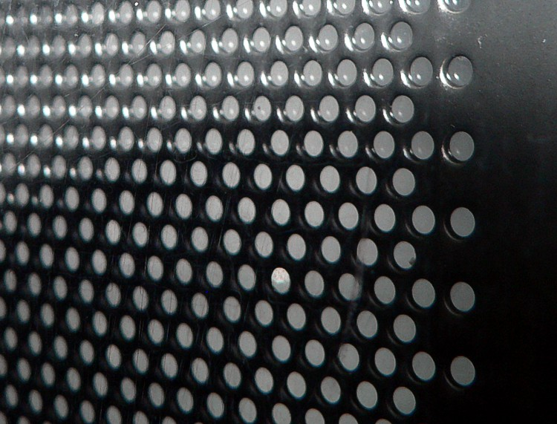

Slide 2


Slide 7
Wave Crests
Rays

Slide 8
Question 9.1
A specular reflector is ……..
A reflector that is spectacular!
One that can cook a hot dog
Like a mirror
A rough surface

Slide 9
Rays

Slide 11
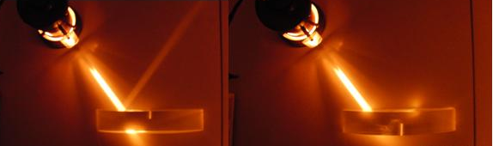

Slide 12
θ_{i}
θ_{r}

Slide 13
Question 9.2
A diffuse reflector is ……..
A reflector that is spectacular!
One that can cook a hot dog
Like a mirror
A rough surface

Slide 14
Law of Reflection, cont.
The angle of reflection is equal to the angle of incidence
θ₁’= θ₁
This relationship is called the Law of Reflection
The incident ray, the reflected ray and the normal are all in the same plane

Slide 15
Retroreflection
Assume the angle between two mirrors is 90º
The reflected beam returns to the source parallel to its original path
This phenomenon is called retroreflection
M₂
Incident Light
40.0°
1.25m
M₁

Slide 16
Retroreflection
Assume the angle between two mirrors is 90º
The reflected beam returns to the source parallel to its original path
This phenomenon is called retroreflection
θ₄
θ₃
θ₁
θ₂
α

Slide 17
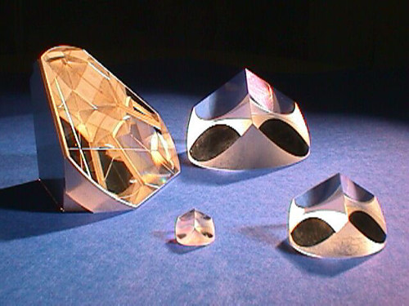

Slide 18
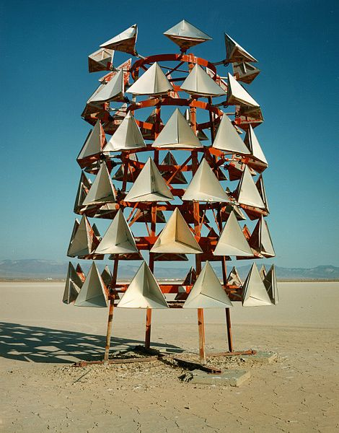
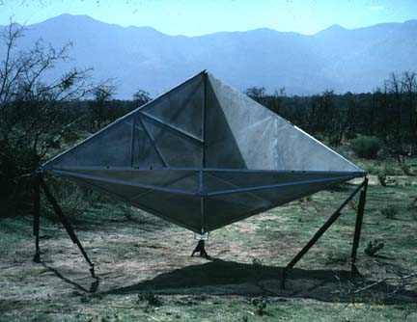
Retroreflectors

Slide 19
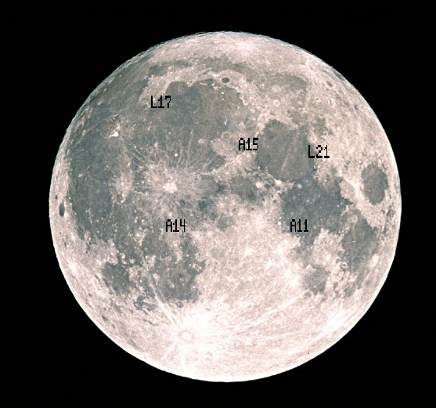
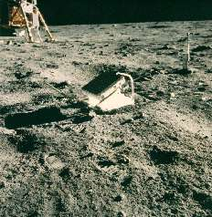
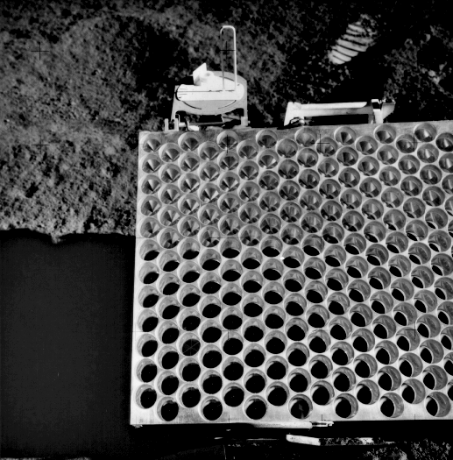
Apollo Retro-reflectors

Slide 20
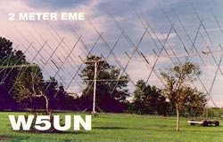
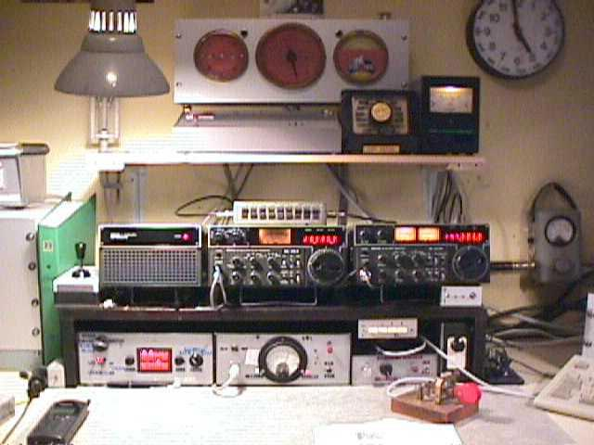
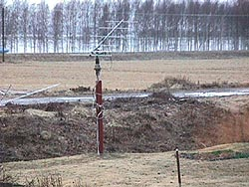
Try it at Home
Amateur Radio Moonbounce Communication
http://www.arrl.org/news/features/2002/01/21/1/

Slide 21
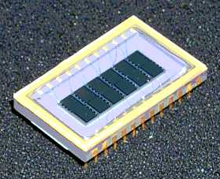
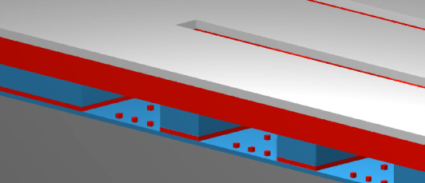
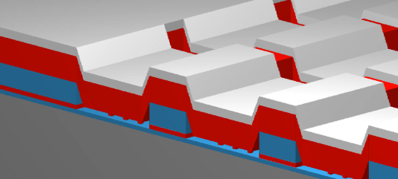
Micro Mirror Arrays
A high-tech example is the new micro-mirror arrays
ITT version
Metal “Mirror”
+-
GEMS Device Off-State
GEMS Device On-State
6 channel GEMS Device
(50 Channel Device is in Development)

Slide 22
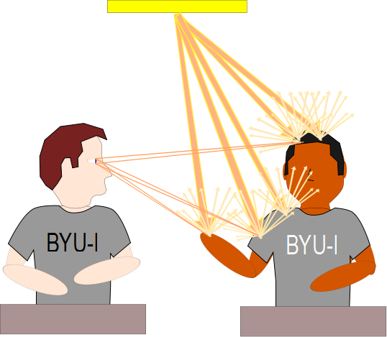

Slide 23
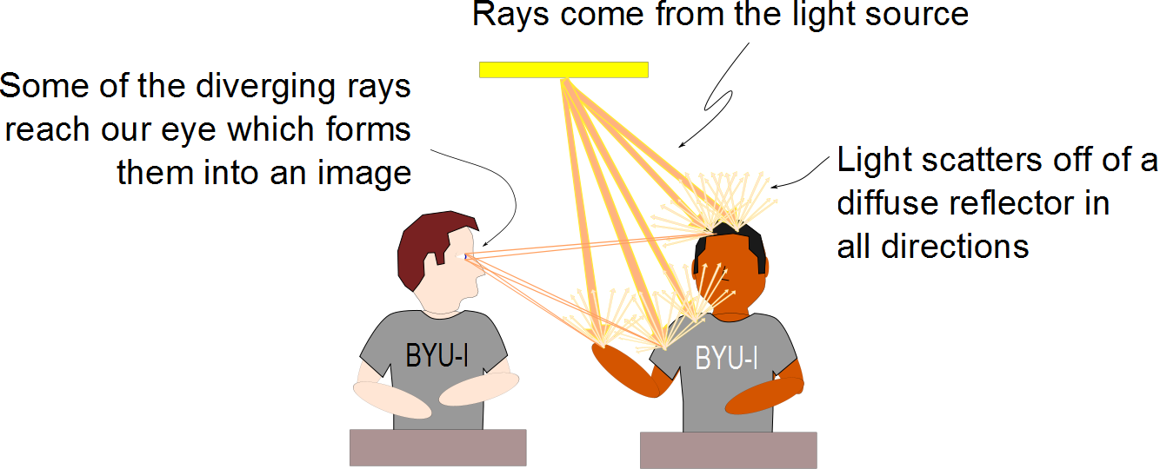

Slide 24
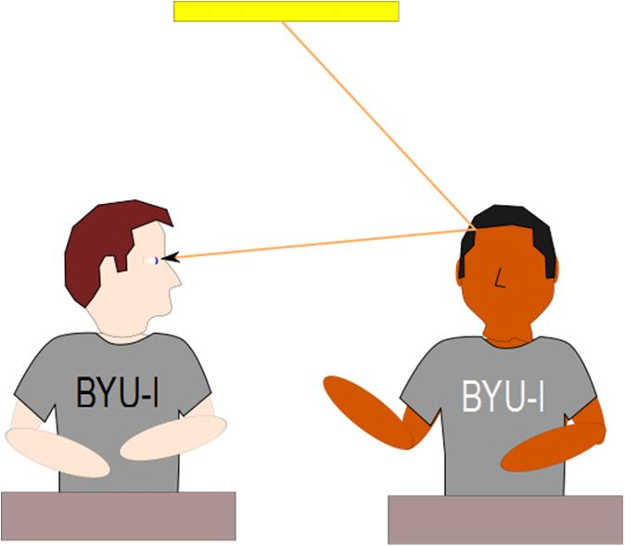
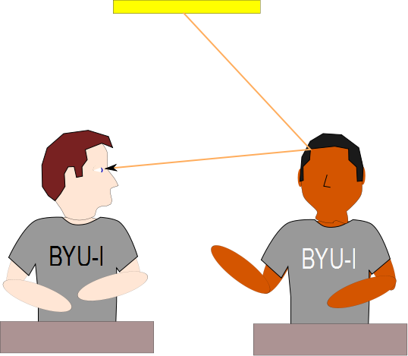

Slide 25
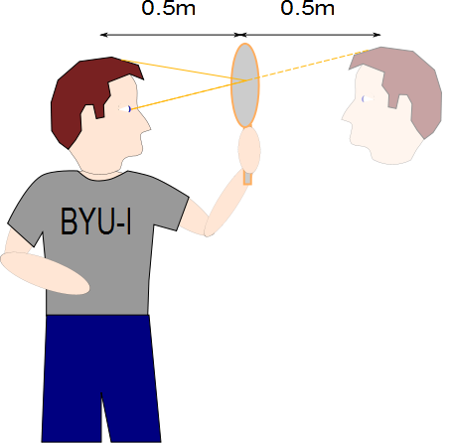

Slide 26
